Slide 1
HARNESS THE POWER OF MENTORSHIP

Slide 2
Erika Ritter Front-End Developer Twitter: JavaScriptErika

Slide 3
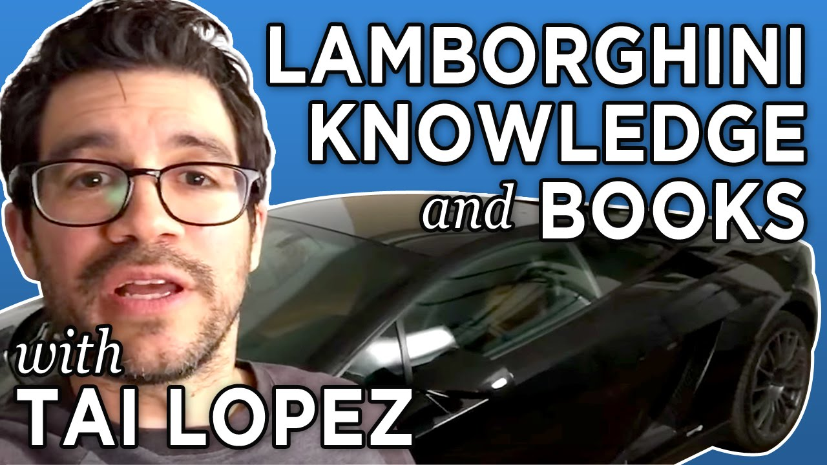
Bring on the
cringe
Mentoring always felt out of reach
It doesn’t have to be this way
Let’s demystify it

Slide 4
Mentor – an experienced or trusted adviser
Mentee – someone who is being advised

Slide 5
Where do I find mentors / mentees?

Slide 6
Create a Professional Social Media Account
Share Work
Let your voice be heard
Follow people you look up to

Slide 7
Get Connected
@CodeNewbies
Twitter Chat: every Wed at 9pm EST
#mentorMonday every other Mon at 9pm EST

Slide 8
Get Connected
@ThePracticalDev
Twitter Chat: every Tuesday at 9pm EST
Vote on topics before chat

Slide 9
How do we begin the Mentor / Mentee Relationship?

Slide 10
Send a Message!
“Hey [developer]! My name’s [Erika], I’m a front end developer who is getting into web animation. I’m a big fan of your work, do you have advice or projects on how to get started with SVG animation to make myself marketable?
Thank you for your time!

Slide 11
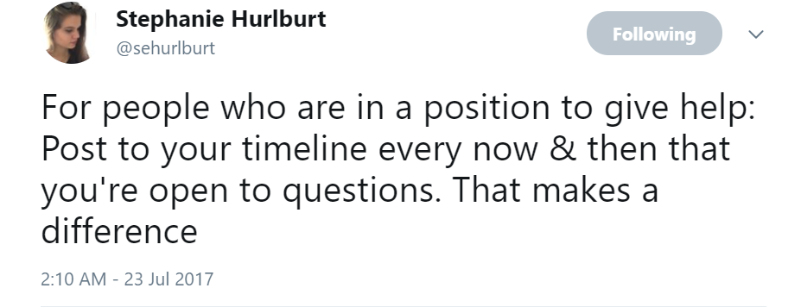
Senior Developers,
Show You’re Available

Slide 12
What Does Mentorship ‘Look’ Like?
There’s no set formula
Mentorships can be involved, casual, or somewhere in-between
Mentoring methods can vary
OS projects, answer questions, discuss fundamentals
Connect with similar goals
Don’t be afraid to reach out to multiple mentors or mentees

Slide 13
Why is Mentoring Crucial in Our Industry?

Slide 14
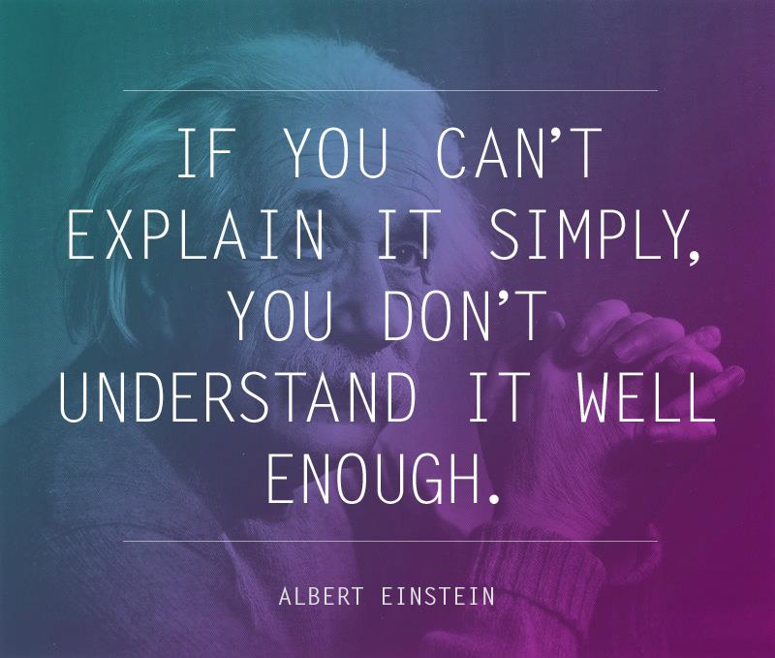
EXPLAIN
WHAT
YOU KNOW

Slide 15
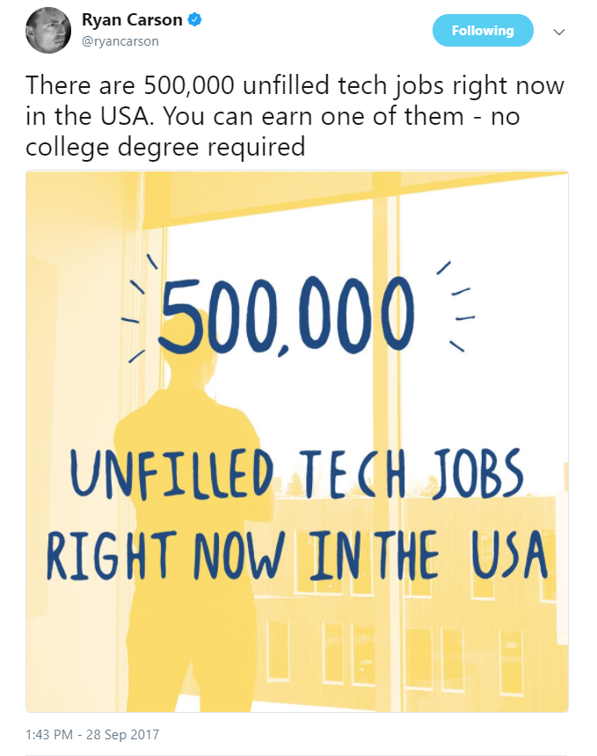
Code is a Collaborative Opportunity
Code is a trade skill
We’ve all learned from others
Mentoring helps create better code
Mentoring expedites the learning process for mentees.
Mentoring makes senior developers better and the workplace better

Slide 16
How to Harness the Power of Mentorship
Demystify the experience
Set up professional accounts
Connect with each other
Mentorship looks diverse
It can vary from one question, to in-depth
Brings value to the industry
Accelerates learning, sharpens skills

Slide 17
When Does this Process Start?
NOW!
I challenge you to meet 10 new people today and connect

Slide 18
THANK
YOU
FOR YOUR
TIME

